Slide 1

Hospital System

Slide 2

About System
Our system consists of 3 main departments :-
Admin Department
Receptionist Department
Doctor Department

Slide 3
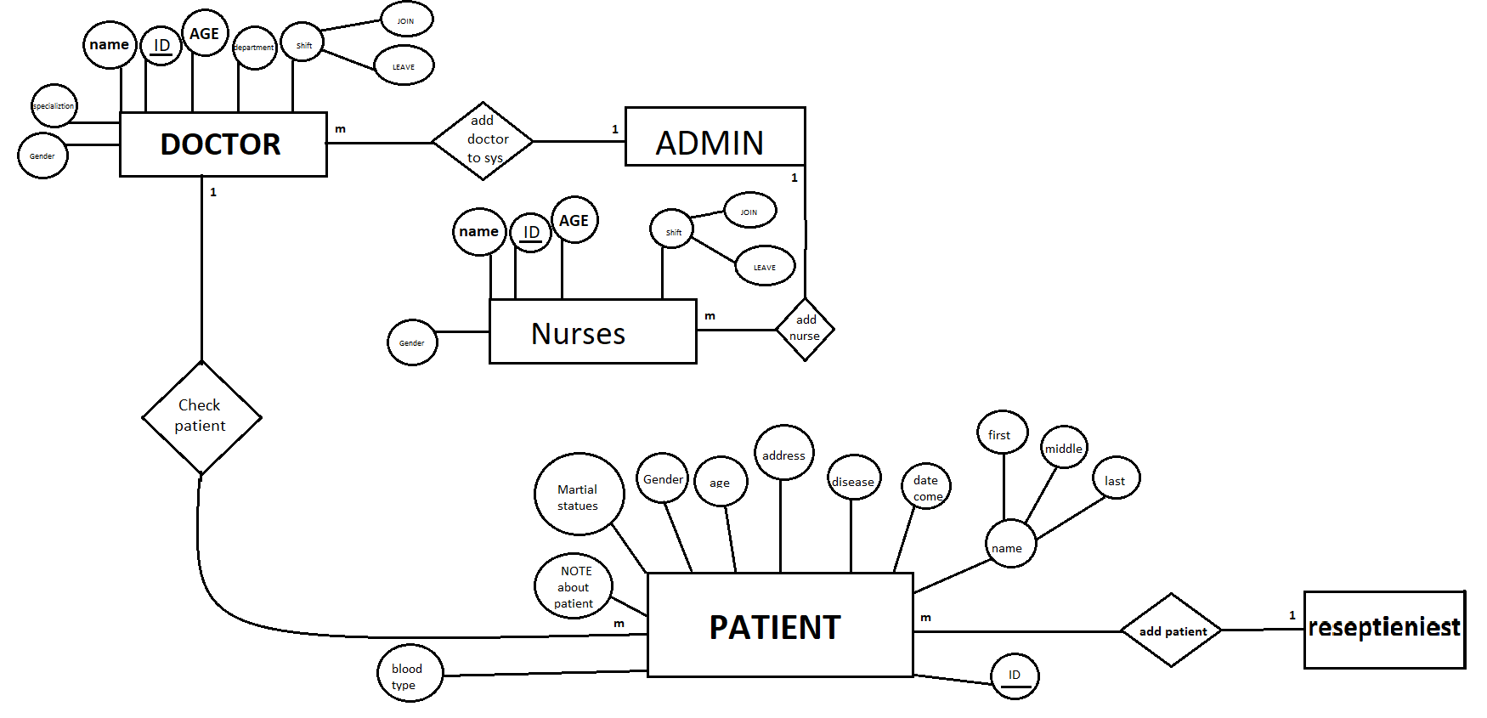
The Entity Relationship Diagram Of The System

Slide 4
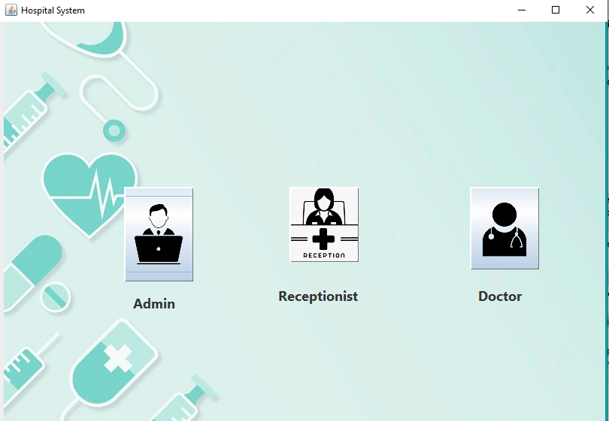
The first GUI
We start with this interface for user.
So, he can choose from the three departments .
Admin department.
Doctor department.
Receptionist department.

Slide 5

Admin Department
This department is responsible for:-
Recording and adding The information about doctors and nurses.
Updating the information about the doctors and nurses.
Deleting the unneeded data or the whole information about either doctors or nurses or both.
Searching about the information.

Slide 6
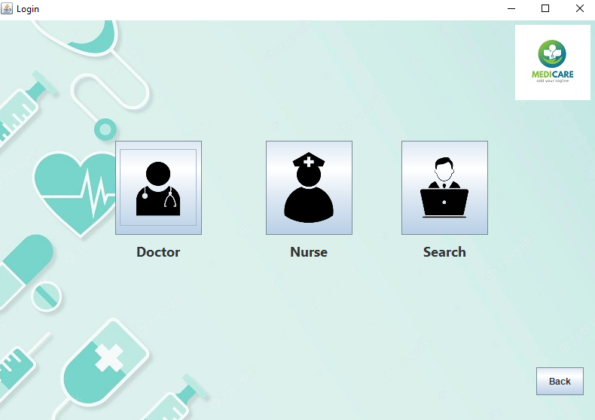
Admin Department
Here the Admin can choose from those three sections .
Doctor :for adding or update the information about doctor.
Nurse :for adding or update the information about nurse.
Search :for searching for the information about nurse or doctor.

Slide 7
Admin Department
Doctor’s Section Functions
Adding the Identification Data (ID)of the doctor in the system.
Adding the username and password of the doctor in the system.
Adding the name ,age ,address ,phone number ,gender ,department and Specialization of the doctor in the system.
Adding the Time of Attendance and leave of the doctor in the system.
Updating or modify the information from getting the id.

Slide 8
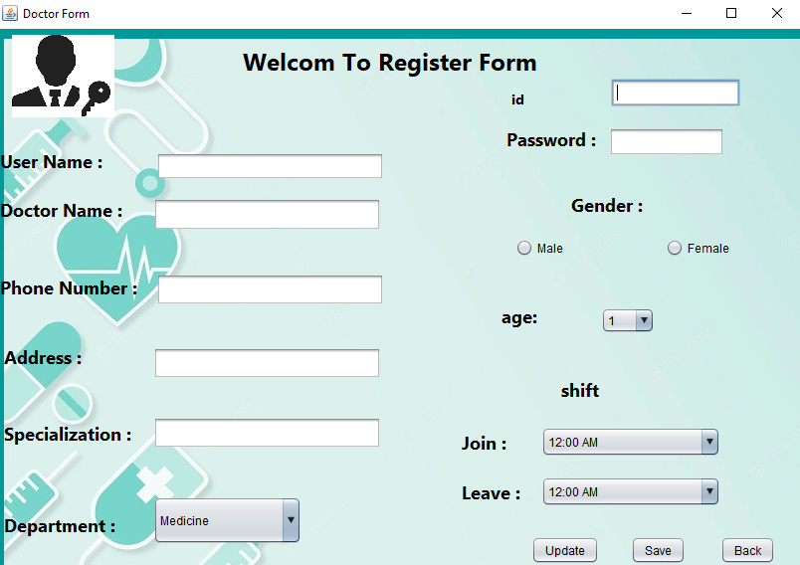
Admin Department

Slide 9
Admin Department
Nurse’s Section Functions
Adding the Identification Data (ID)of the nurse in the system.
Adding the name , age , address , phone number , and gender of the nurse in the system.
Adding the Time of Attendance and leave of the Nurse in the system.
Updating or modify the information from getting the id.
Deleting the nurse from the system.
Search about nurse's information.

Slide 10
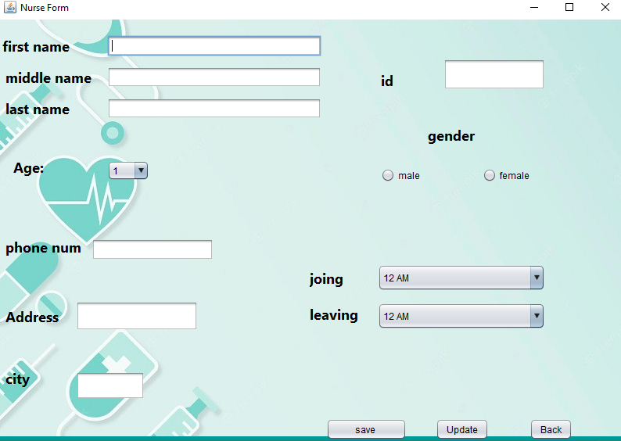
Admin Department

Slide 11
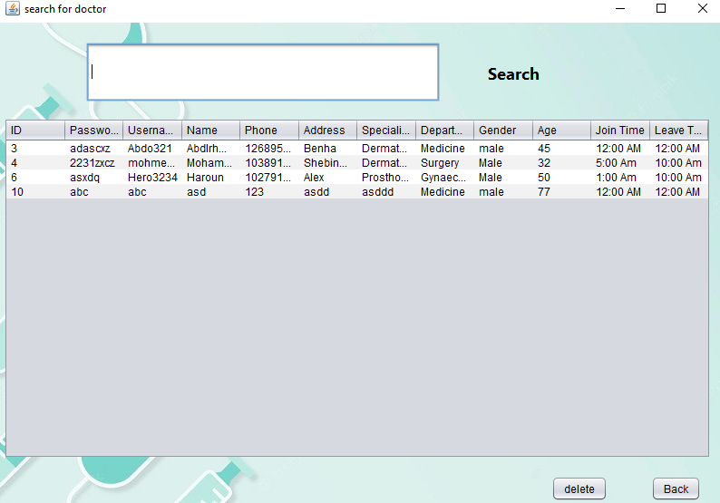
Admin Department
Doctor’s search Section Functions
Searching for the information about doctor.

Slide 12
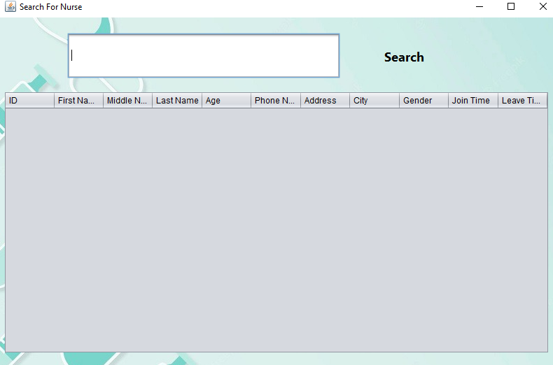
Admin Department
Nurse’s search Section Functions
Searching for the information about nurse.

Slide 13

Receptionist Department
This department is responsible for:-
Receiving new and existing patients.
Adding new patients.
Searching for existing patients.

Slide 14

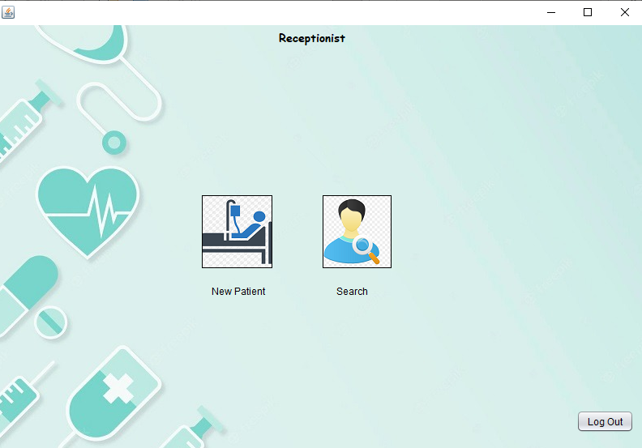
Receptionist Department
As we can see here the receptionist can select from two bottoms.
New patient :for adding a new one.
Search :for searching about an existed patient.

Slide 15
Receptionist Department
New patients’ Section Functions
Adding new patients’ Identification Data (ID) in the system.
Adding new patients’ name, age ,phone number ,address , date of coming , martial status, and blood type in the system.
Updating and modify the information about the new patients in the system.

Slide 16
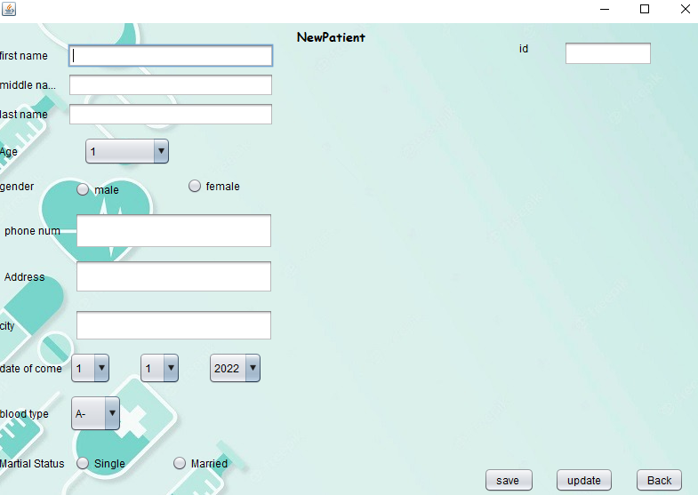
Receptionist Department

Slide 17
Receptionist Department
existing patients’ Section Functions
Searching for information about existing patients like their id , name , blood type ,…etc.
Delete patients who have spent their treatment period.

Slide 18
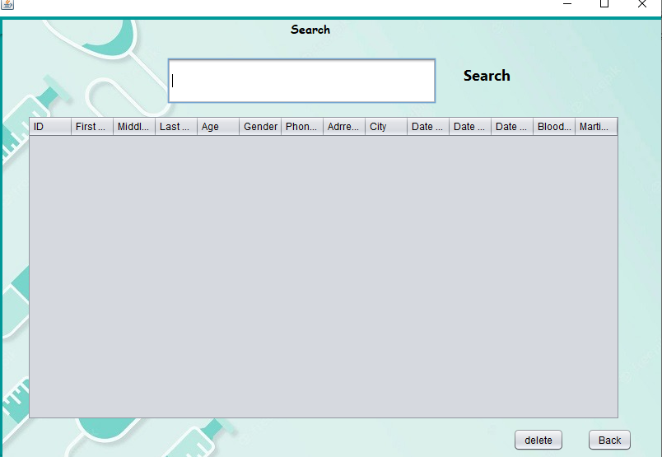
Receptionist Department

Slide 19

Doctor Department
This department is responsible for:-
Getting patients’ information from the system.
Diagnosing the patient's condition.
Recording treatment, medication, and any notes on the patient's condition.

Slide 20

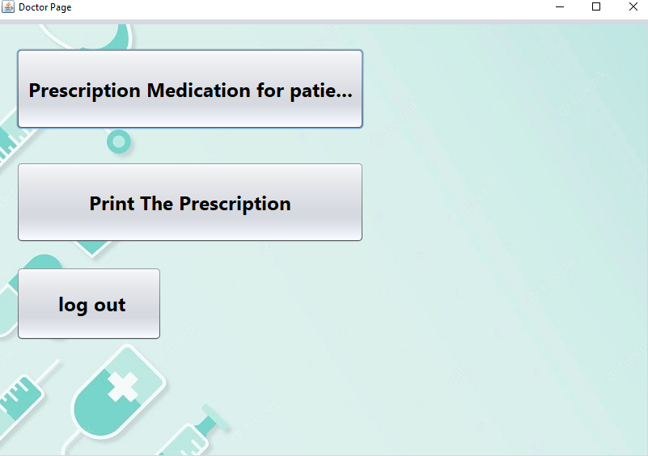
Doctor Department
Here the Doctor can choose from three options.
Prescription Medication for patient
Print The Prescription.
Go out from this page.

Slide 21
Doctor Department
Prescription Medication For Patient Functions
Updating the patient's information.
Recording treatment, medication, and any notes on the patient's condition.

Slide 22
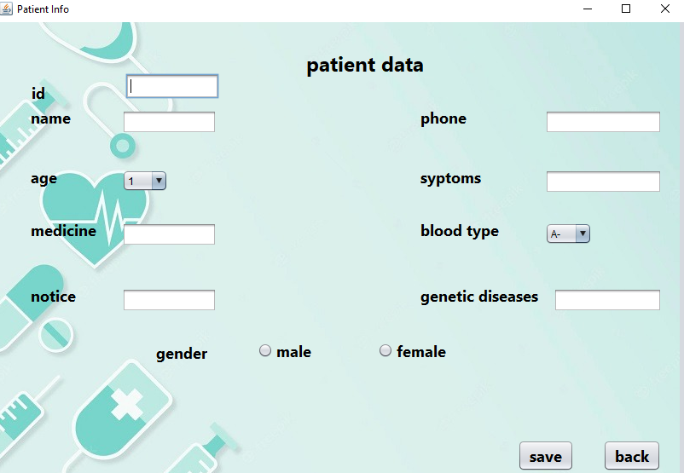
Doctor Department

Slide 23
Doctor Department
Print The Prescription Functions.
Getting the information form the patient id.
Printing the prescription and notes about the diseases.
Getting the phone number to make the doctor be able to communicate with the patients.

Slide 24
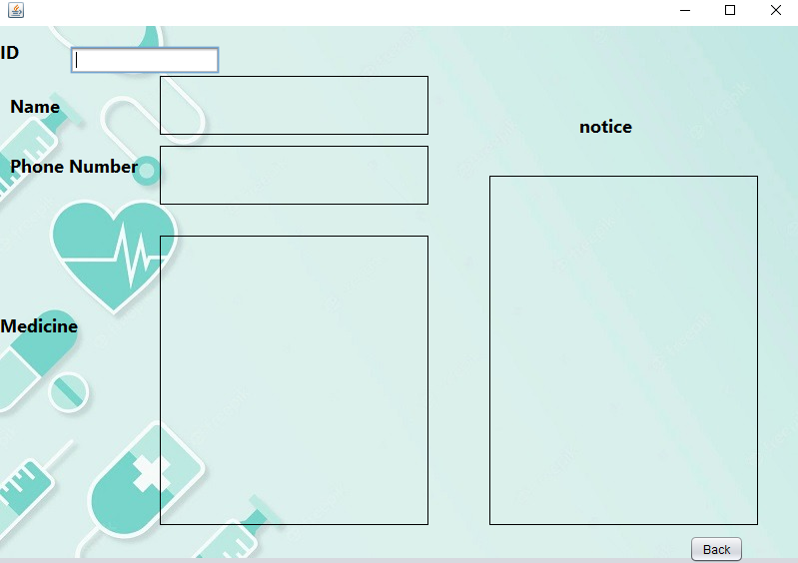
Doctor Department

Slide 25

Thank you

